Slide 1
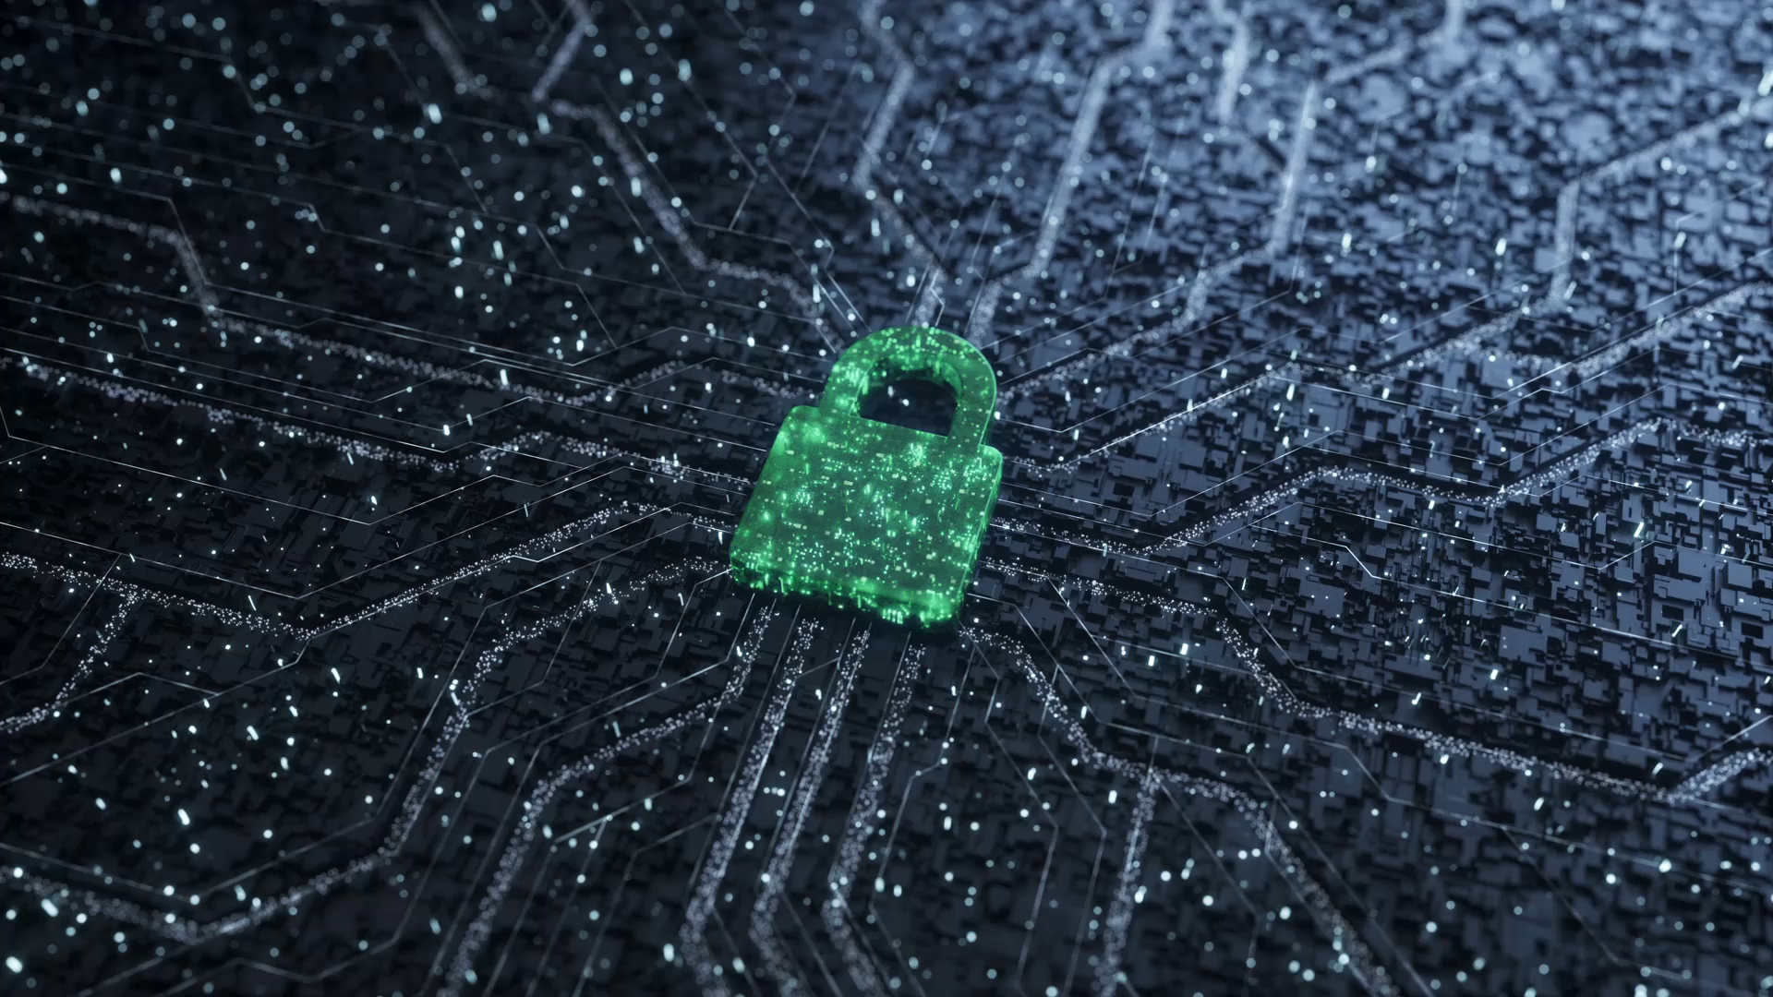
Virtualization Security
CIS 360 – Prof. C. R. Johnson
University of Wisconsin – Stevens Point

Slide 2
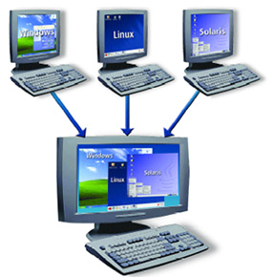
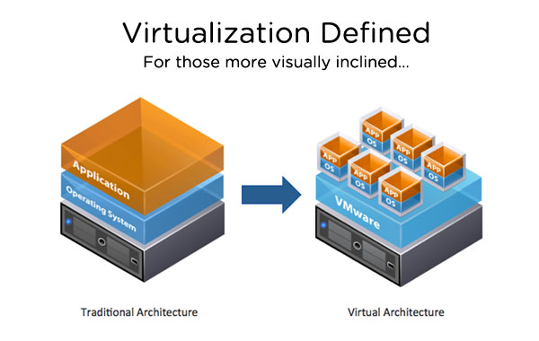
Introduction
A VM is a software implementation of a machine that execute programs like a physical machine
A VM can support individual processes or a complete system depending on the abstraction level where virtualization occurs.
Virtualization – a technology that allows running two or more OS side by side on one PC or embedded controller
Notes:
1. In Old days we used huge amount of computer station with different OS, HW and SW configurations. It is required big efforts for IT, administration and maintenance. The big Question was how make SW portable and compatible? The were a couple attempts, 1st was in HW: HW designers for various computer companies gravitated toward certain common features and big success was IBM 360 series computer, 2nd attempt was in OS: OS starts to standardize their interfaces to the upper application layer, and it was big success as well, that allows to develop large, complex, varied application and provide flexibility and portability to application. “As a reminder, OSs are responsible for managing HW resources, isolation, sharing, hiding idiosyncrasies of the underlying HW.” However it was not perfect, because OS/Application needs certain properties which only certain “real machine” can provide. So, VM, compared to real machine, is invented to provide the same properties OS/Application need which only real machine can provide before. VM may have an different OS from Underlying real HW and/or may have an instruction set.
2. Some VMs support flexible hardware usage and software isolation, while others translate from one instruction set to another.
3. What is virtualization concepts? There are HW and Application Virtualizations. HW Virtualization: Makes an OS think it is running on it own HW, Abstracts the HW from the OS, known forms of HW Virtualization are VMware, MS Virtual PC, XEN. Appl Virtualization: Makes an application thinks it is running in its own OS, Abstracts the services and kernel from an application, known forms of Appl Virtualization are Thinstall and Softgrid. The heart of virtualization is VM, a tightly isolated software container with an operating system and application inside. Because each VM is completely separate and independent, many of them can run simultaneously on a single computer. A thin layer of software called a hypervisor decouples the VMs from the host, and dynamically allocates computing resources to each VM as needed.

Slide 3
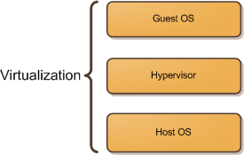
VM Architecture
Virtualization
Host OS
Guest OS
Hypervisor
Notes:
To begin, let me introduce three very simple concepts regarding virtualization: the host operating system, the hypervisor, and the guest operating system.
The host operating system provides a host to one or more virtual machines (or partitions) and shares physical resources with them. It’s where the virtualization product or the partitioning product is installed.
The guest operating system is the operating system installed inside a virtual machine (or a partition). In a virtualization solution the guest OS can be completely different from the host OS. In a partitioning solution the guest OS must be identical to the host OS.
A hypervisor, also called a virtual machine manager (VMM), is a program that allows multiple operating systems to share a single hardware host. Each operating system appears to have the host’s processor, memory, and other resources all to itself. The task of this hypervisor is to handle resource and memory allocation for the virtual machines, ensuring they cannot disrupt each other, in addition to providing interfaces for higher level administration and monitoring tools.

Slide 4
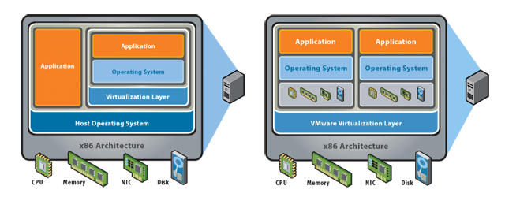
VM Architecture
There are two common approaches to virtualization: "hosted" and "bare-metal“
Hosted
Bare - Metal
Notes:
Hosted virtualization software runs as an application or "guest" on top of a general-purpose operating system.
In this architecture, a base operating system (such as Windows) is first installed. A piece of software called a hypervisor or virtual machine monitor (VMM) is installed on top of the host OS, and allows users to run various guest operating systems within their own application windows
Hosted Hypervisor relies on an underlying OS, more security implications because of the reliance on the underlying OS, used in VMware Workstation/Server/Player and MS Virtual PC.
2. Bare-metal virtualization interfaces directly with computer hardware, without the need for a host operating system. In this architecture, a VMM (also called hypervisor) is installed that communicates directly with system hardware rather than relying on a host operating system.
In Bare Metal Hypervisor virtualization Engine Installs directly on HW, there is no reliance on an underlying OS, used in VMware ESX Server, XEN and MS Hyper V.

Slide 5
VM Architecture
Security Concepts in Architecture
Extended computing stack
Guest isolation
Host Visibility from the Guest
Virtualized interfaces
Management interfaces
Greater co-location of data and assets on one box
Notes:
What are security concepts in VM Architecture?
New privileged layers (Hypervisor) exist underneath the operating system that need to be considered
One guest VM cannot be allowed to access or even address the “hardware resources” of another guest VM or the host/hypervisor
Can the guest OS detect that it is virtualized and if so can it see anything on the host
Physical connectivity between guests is recreated, e.g. IP network, file shares, may be more or less like true physical counterparts
The protection of management interfaces (Console OS, VirtualCenter, etc...) very important. Root or Administrator Access to these interfaces provides “keys to the kingdom”
Concept of mixing of Trust/Security Zones on a single physical box

Slide 6
VM Security Benefits
Abstraction and Isolation
Better Forensics and Faster Recovery After an Attack
Patching is Safer and More Effective
More Cost Effective Security Devices
Future: Leveraging Virtualization to Provide Better Security
Notes:
The hardware abstraction and isolation of VM bounds the scope of attack and makes it much more difficult for the attacker to access unauthorized data and resources on the physical machine. The guest is not even aware it is running in a virtualized environment. Since the attacker does not know details of the host environment, manipulating and compromising the machine is much more difficult. Hypervisors are much simpler than traditional OSs, and are therefore much easier to secure. They are nothing more than a microkernel with a hardware compatibility layer and a smaller code base correlates to simplicity, making it easier for software developers to minimize bugs and vulnerabilities. Each VM encapsulates the guest and prevents a malicious guest from accessing resources it does not own. This means that attackers should not be able to compromise the physical machine, only one VM at a time. An attack on the VM should not affect any of the other VMs on the server or the host OS. This is unlike a multi-user OS, where all users can be affected by an attack. In a VM infrastructure, each user can either access a given VM or they cannot. Inside a multi-user OS, a complex and thus vulnerable file system dictates which files each user can read, write, or execute. The isolation and abstraction of VMs provides additional security over a traditional multi-user computer. When a VM is compromised, the hypervisor can remove that VM or restore it to a state prior to attack.
A compromised machine can be cloned in it current compromised state for forensic analysis. Once cloned the
VM can be immediately restored to a known good snapshot which is much faster than a physical server, reducing the impact of a security-related event
You can quickly revert to a previous state if a patch is unsuccessful, making you more likely to install security patches sooner. You can create a clone of a production server easily, making you more likely to test security patches and more likely to install security patches. VMware Update Manager does patch scanning and compliance reporting, along with patch remediation for both online and offline VMs – again, making it more likely that security patches will be installed
You can put in place cost effective intrusion detection, vulnerability scanning, and other security related appliances, because you can put them in a VM instead of a physical server
Better Context – Provide protection from outside the OS, from a trusted context. New Capabilities – view all interactions and contexts: CPU, Memory, Network, Storage.

Slide 7
VM Security Issues
VM Sprawl
Mobility
Hypervisor Intrusion
Hypervisor Modification
Communication
Denial of Service
Notes:
Like physical machines, VMs are vulnerable to theft and denial of service attacks. The contents of the virtual disk for each virtual machine are usually stored as a file, which can be run by hypervisors on other machines, allowing attackers to copy the virtual disk and gain unrestricted access to the digital contents of the virtual machine. Since VMs share resources from the physical machine, VM infrastructures were particularly vulnerable to denial of service attacks, which could starve resources from all VMs on the physical machine
The single biggest vulnerability of VMs is due to the ease in which users can create many VMs, which become very difficult to secure, monitor, and maintain. VMs can be created and deployed in a matter of seconds, which is significantly smaller than the time to ensure that all VMs are up-to-date and secure. Traditional security methods need to be applied to each VM because the guest OS accesses the network directly. A compromised VM is a potential entry point for attackers to the hypervisor and host. Most current security products are not designed for efficient use in securing many VMs on the same physical server, but this is a problem many software companies are working on. In addition to creating more work for security administrators, VM sprawl wastes resources and creates more entry points for attackers. An obsolete VM becomes an easy entry point for attackers, who could potentially access the hypervisor, other VMs, and the host OS.
Virtual machines are inherently not physical, which means their theft can take place without physical theft of the host machine. The contents of the virtual disk for each VM are stored as a file by most hypervisors, which allows VMs to be copied and run from other physical machines. While this is a convenience feature, it is also a security threat. Attackers can copy the VM over the network or to a portable storage media and access data on their own machine without physically stealing a hard drive. Once attackers have direct access to the virtual disk, they have unlimited time to defeat all security mechanisms, such as passwords, using offline attacks. Since the attacker is accessing a copy of the VM rather than the original, the VM will not show any records of intrusion. The second danger of virtual disks is that the attacker could corrupt or externally modify the file while the VM is offline. This means the integrity of an offline VM may be compromised if the host is not securely protected. This is not usually an issue with physical servers because the machine must be running to be accessible by network. Modern encryption and integrity algorithms can be applied by the host hypervisor so that access and integrity are ensured.
The hypervisor provides the abstraction and resource allocation between the host and guests. Attackers ultimate goal is to compromise the hypervisor to gain with the ability to execute arbitrary code on the host with the privileges of the [hypervisor] process. The hypervisor is a program, running on the host, so if it is compromised, all VMs it controls and the host itself are accessible to the attacker. The hypervisor converts instructions for the guest OS into instructions for the host OS, however, if the guest is compromised, then the instructions sent to the hypervisor may be irrational. Researchers X ran two tools, crashme and iofuzz, which generate random I/O port activity inside the virtual machines, until the hypervisor or VM crashed. The details of these attacks are not included in this paper because they were unique to each VM implementation, and all flaws detected we fixed before the paper was published. They were able to compromise the hypervisor and access the host using any major hypervisor available to the public. However, hypervisors are generally more secure than OSs, since the hypervisor is a relatively small and simple program, which helps to limit low-level vulnerabilities that may be present in many programs.
It does not matter how secure the original hypervisor is if it can be externally modified to use the attackers software. One attack of this form is known as Virtual Machine Based Root Kits (VMBR). In this attack, the hypervisors system calls to the host OS are changed to run malicious code instead. Fortunately, there are several methods for preventing hypervisor modification. The host can use a trusted platform module (TPM) to create a trusted relationship with the hypervisor. Alternatively, the guest can verify the integrity of the hypervisor when it boots. A third solution is to use an embedded hypervisor. An embedded hypervisor runs without a host OS and inherently cannot be modified.
VM Communication refers guest-to-guest attacks, in which attackers use one VM to access or control other VMs on the same hypervisor. These attacks can happen with out without compromising the hypervisor layer. A malicious VM can potentially access other VMs through shared memory, network connections, and other shared resources. For example, if a malicious VM determines where another VM s allocated memory lies, then it could read or write to that location and interfere with the others operation. Sometimes it is desirable for two VMs to be able to communicate. This has many applications, such as for dedicated monitoring of a VM or implementing a network technology that requires multiple peers. Instead of providing full isolation, IBMs sHype is intended to be a secure architecture for addressing inter-VM communication in a VM infrastructure. sHype allows system administrators to define policies for communication between each VM and ensure that only authorized VMs have access to communicate with each other.
DoS attacks are a threat to all servers, however an improperly configured hypervisor can allow a single VM to consume all resources, thus starving any other VM running on the same physical machine. DoS attacks make network hosts unable to function since critical processes do not have the hardware resources to execute in a timely manner. Fortunately, the solution is simple. Hypervisors prevent any VM from gaining 100% usage of any resources, including CPU, RAM, network bandwidth, and graphics memory. Additionally, the hypervisor can be configured so that when it detects extreme resource consumption, it can evaluate whether an attack is being made and automatically restart the VM. VMs can usually be initialized much faster than physical machines because their boot sequence does not need to initialize and verify hardware, so restarting the VM has a smaller effect than restarting a physical machine.

Slide 8
VM Security Issues
Issue | Hosted | Bare-Metal
Vulnerability of the underlying operating system | Hosted virtualization products run on general-purpose operating systems and are susceptible to all the vulnerabilities and attacks that are prevalent on such systems. | VMware bare-metal virtualization is built around the “VMkernel”, a special-purpose microkernel that has a much smaller attack surface than a general-purpose operating system.
Sharing of files and data between the guest and the host | Most hosted virtualization products provide methods to share user information from the guest to the host (shared folders, clipboards, etc). Although convenient, these are vulnerable to data leakage and malicious code intrusion. | Since ESX is designed specifically for virtualization, there is no mechanism or need to share user information between virtual machines and their host.
Notes:
Let’s review the common security issues and the implications of choosing a hosted versus bare-metal virtualization platform.

Slide 9
VM Security Issues
Issue | Hosted | Bare-Metal
Resource allocation | Hosted virtualization products run as applications in the process space of the host OS. They are at the mercy of the host OS and other applications. | VMware bare-metal virtualization allocates resource intelligently while isolating virtual machines from underlying hardware components. No single virtual machine can use all the resources or crash the system.
Target Usage | Hosted virtualization is targeted for environments where the guest virtual machines can be trusted. This includes software development, testing, demonstration, and trouble-shooting. | ESX is meant to be used in production environments in which the guest virtual machines can potentially be exposed to malicious users and network traffic. Strong isolation and strict separation of management greatly reduce any risk of harmful activity going beyond the boundaries of the virtual machine.

Slide 10
VM Security Concerns
Managing oversight and responsibility
Patching and maintenance
Visibility and compliance
VM sprawl
Managing Virtual Appliances
Notes:
The biggest problem with VMs, Steffen and MacDonald say, is the potential for IT or security managers to lose control of them simply by not being able to see the risks as they crop up. Here's a look at the five top virtual server security concerns of the moment.
The overarching issue with virtual servers is responsibility. Unlike physical servers, which are the direct responsibility of the data-center or IT managers in whose physical domain they sit, responsibility for virtual servers is often left up in the air. Should the business-unit that requested it be able to configure and secure it? Should it be the IT manager closest to the physical host? A centralized master sysadmin tasked with management and security for all the virtualized assets in an enterprise? "People don't appreciate that when you add virtual servers there's another layer there of technology in addition to the application and the operating system and the hardware, and you have to secure it.
The most tangible risk that can come out of a lack of responsibility is the failure to keep up with the constant, labor-intensive process of patching, maintaining and securing each virtual server in a company. Unlike the physical servers on which they sit, which are launched and configured by hands-on IT managers who also install the latest patches, virtual machines tend to be launched from server images that may have been created, configured and patched weeks or months before. Most companies maintain a small number of general-purpose "golden" images from which to launch or relaunch new VMs for many purposes, but also keep dozens or hundreds of server images stored on DVD or disk after being laboriously configured to support specific applications or business requirements. Both Microsoft and VMware supply patch-management schedules with their base infrastructure products. Both require disk images stored in libraries to be launched periodically so they can be patched.
Virtual servers are designed to be, if not invisible, then at least very low profile, at least within the data center. All the storage or bandwidth or floor space or electricity they need comes from the physical server on which they sit. To data-center managers not specifically tasked with monitoring all the minute interactions of the VMs inside each host, a set of virtual servers becomes an invisible network within which there are few controls. "Virtual switch implementations let the VMs talk to each other, and across the network, But unless you put virtualized security controls—virtual sniffers, virtual firewalls, all the same controls you'd use on a physical server, inside that network, you don't see what's going on." "There are a lot of compliance and use issues, Just because you don't have a sniffer to see those packets moving between the virtual servers doesn't mean they're not there,“
Another consequence of the lack of oversight of virtual machines is sprawl—the uncontrolled proliferation of virtual machines launched, and often forgotten, by IT managers, developers or business-unit managers who want extra servers for some specific purpose, and lose track of them later. VM sprawl wastes resources, creates unmonitored servers that could have access to sensitive data, and sets the company as a whole and IT in particular up for a painful cleanup when a problem crops up later.
One of the very best things about virtual infrastructures is the ability to buy or test a product from a third-party vendor and have it up and running in minutes, rather than having to clear space on a test server, install the software, get it to talk to the operating system and the network and then, hours later, see whether it does what it's supposed to. Unfortunately, virtual appliances are also virtual pigs in a poke. "There's an operating system and application in every package, every one with its own configuration and patch status and you have no idea what's in there or who's going to maintain it or what the long-term risk is going to be, It has a full application and OS all configured and ready to run. In five minutes you can try out that new anti-spam server.

Slide 11
The Challenge
VM₀
VM₁
Guest processes
Guest processes
How can we take an OS and user-mode processes, and trick them into thinking that they’re running on bare metal?
Guest OS
Guest OS
Virtual hardware interface
Hypervisor
Real hardware interface
Hardware
Also called a VMM
(“virtual machine monitor”)

Slide 12
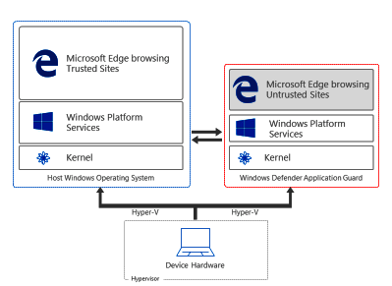
Why Is Virtualization Useful?
Security: Isolation between VMs is useful if VMs don’t trust each other, and/or host doesn’t trust VMs
Ex: In Windows 10 Enterprise, navigating to an untrusted website will open the web browser inside of a Hyper-V VM
Notes:
[Note that some of the Application Guard documentation refers to Hyper-V “containers,” but, as described in Reference [3], those “containers” are not Docker-style containers---they’re actually VMs.]
[Ref: [1] https://docs.microsoft.com/en-us/windows/security/threat-protection/windows-defender-application-guard/wd-app-guard-overview
[2] http://www.miru.ch/demystifying-windows-defender-application-guard/
[3] https://docs.microsoft.com/en-us/virtualization/windowscontainers/manage-containers/hyperv-container
[4] https://www.itprotoday.com/windows-8/differences-between-windows-containers-and-hyper-v-containers-windows-server-2016
]

Slide 13
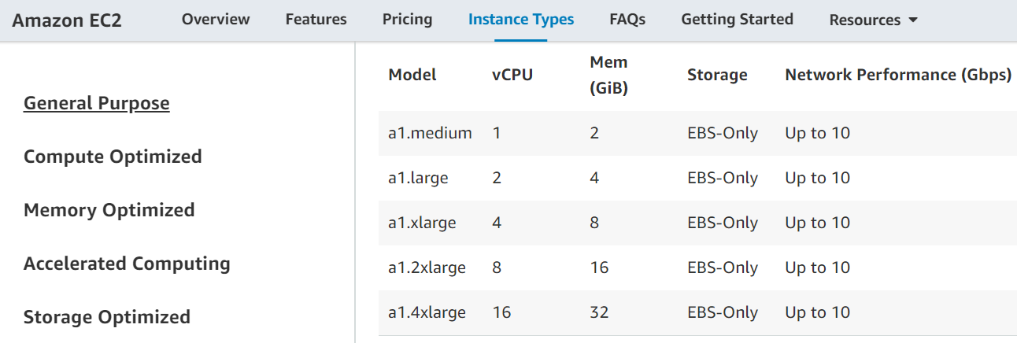
Why Is Virtualization Useful?
Server consolidation: VMs make it easy for the owner of a physical machine to rent that machine to others
Cram a bunch of somewhat-busy server apps onto a single physical machine
Cheaper than allocating a separate physical server per app
Ex: A multi-tenant datacenter like Amazon’s EC2 runs code from multiple parties on a single physical server

Slide 14
How Can We Implement Virtualization?
Hosted Interpretation
Popek-Goldberg VMMs
Dynamic Binary Translation
Hardware-assisted Virtualization

Slide 15
Hosted Interpretation
Run the VMM as a regular user application atop a host OS
VMM maintains a software-level representation of physical hardware
VMM steps through the instructions in the code of the VM, updating the virtual hardware as necessary
while(1){
curr_instr = fetch(virtHw.PC);
switch(curr_instr){
case ADD:
int sum = virtHw.regs[curr_instr.reg0] +
virtHw.regs[curr_instr.reg1];
virtHw.regs[curr_instr.reg0] = sum;
break;
case SUB:
//...etc...
Notes:
[Ref: http://bochs.sourceforge.net/Virtualization_Without_Hardware_Final.pdf]

Slide 16
Hosted Interpretation
Good: Easy to interpose on sensitive operations
The guest OS will want to read and write sensitive registers (e.g., %gs, %cr3), send commands to IO devices (e.g., inb), etc.
The interpreter can handle sensitive operations according to a policy
Ex: All VM disk IO is redirected to backing files in the host OS
Ex: VM cannot access the network at all, or can only access a predefined set of remote IP addresses
Good: Provides “complete” isolation (no guest instruction is directly executed on host hardware)
Good: Virtual ISA can be different than the physical ISA
Bad: Accurately emulating a modern processor is difficult
Bad: Interpretation is slow! [Ex: Bochs is 2x—3x slower than direct execution]

Slide 17
Popek and Goldberg: Terminology
Privileged instructions cause a trap if the processor isn’t in privileged mode
Sensitive instructions access low-level machine state (e.g., page tables, IO devices, privilege bits) that should be managed by control software (i.e., an OS or a VMM)
Safe instructions are not sensitive
A VMM is a control program that is:
Efficient: All safe guest instructions run directly on hardware
Omnipotent: Only the VMM can manipulate sensitive state
Undetectable: A guest cannot determine that it is running atop a VMM
Notes:
[Aside: The precise definition of a “third-generation computer” isn’t important with respect to the pedagogical goals of the lecture. Basically, a third-generation computer (1) has distinct “user” and “supervisor” modes, with user mode only having access to a subset of the instructions and trapping upon executing a supervisor-privileged instruction; (2) the machine uses a base+virt_addr model to generate physical addresses; (3) there are no interrupts or IO instructions. Only the first requirement is actually a strong one. The latter two make the paper’s formal argument easier to prove. See here for more details: https://pdfs.semanticscholar.org/d800/009a27fbc8da40095f9ab59ef72441c654bb.pdf]

Slide 18
Least
User-mode accessible?
privileged
Writeable?
Present?
Ring 3
Ring 2
PTE
4KB-aligned physFrame addr
63
48
47
12
11
3
2
1
0
Ring 1
Intel originally thought that device drivers could be “isolated” here
However, “isolated” drivers in Rings 1 or 2 can still access ring 0 memory pages, so isolation is weak in practice without additional segment-based protection (but segment support was dropped in x86-64)
Also, many non-x86 chips only define two privilege levels, so portable OSes shouldn’t leverage Rings 1 and 2
Ring 0
Most
privileged
x86 Rings
Notes:
On x86, an example of a privileged instruction is the instruction is a mov operation to %cr3. Only Ring 0 code should be able to change the value of %cr3 and therefore change the active address space. Another example of a privileged instruction is the LIDT instruction. This instruction allows code to set the register which points to the interrupt descriptor table.
[Aside: As described by ”Bringing Virtualization to the x86 Architecture with the Original VMware Workstation” [http://www.cs.columbia.edu/~cdall/candidacy/pdf/Bugnion2012.pdf] (Section 6.2.1) an x86-32 can place the VMM in ring 0, the guest OS in ring 1, and the guest apps in ring 3, such that:
*the VMM and the guest OS are protected from each other using segments (so that, even though the x86 MMU treats privilege levels 0--2 as supervisor w.r.t. to the u/s bit in page tables, the guest OS cannot access VMM memory);
*the guest OS and the guest apps are protected from each other (because page protections will prevent the ring 3 guest apps from accessing ring 1 guest OS pages).
However, x86-64 does not support segmentation! So, the guest OS has to be placed in Ring 3, to prevent the guest OS from being able to access hypervisor memory.]
[Aside: Are port-mapped IO instructions privileged? Because x86 is terrible, the answer is obviously “it depends.” As described by https://sites.google.com/site/masumzh/articles/x86-architecture-basics/x86-architecture-basics, the %rflags register has an “IO privilege level (IOPL) flag (2 bits). A task or program (T1) can access IO ports if its current privilege level (CPL) is less than or equal to IOPL. A program or task may get access privilege to a port via the IO bitmap. The POPF (POPF: 16 bit, POPFD: 32 bit or POPFQ: 64-bit architecture) instruction pops the top of the stack into the privileged FLAGS register, as a result of which the IOPL and the IF flags can be modified. The IOPL can only be modified by the POPF and IRET instructions when CPL is 0. A program can modify the IF flag, only if its CPL is less than or equal to the IOPL.”].
[Ref: https://www.virtualbox.org/manual/ch10.html#hwvirt //Section 10.5 describes how, when VirtualBox uses software virtualization,
//it puts the guest OS in Ring 1. This is nice because the guest OS will trap
//when executing privileged instructions, but not all sensitive instructions
//are privileged, so VirtualBox must perform dynamic binary translation.
“Intel Virtualization Technology” by Uhlig et al. http://citeseerx.ist.psu.edu/viewdoc/download?doi=10.1.1.459.3814&rep=rep1&type=pdf
//A great discussion of the challenges of virtualizing x86
]
[References: http://stackoverflow.com/questions/3425085/the-difference-between-call-gate-interrupt-gate-trap-gate //Info about call gates w.r.t. traps]

Slide 19
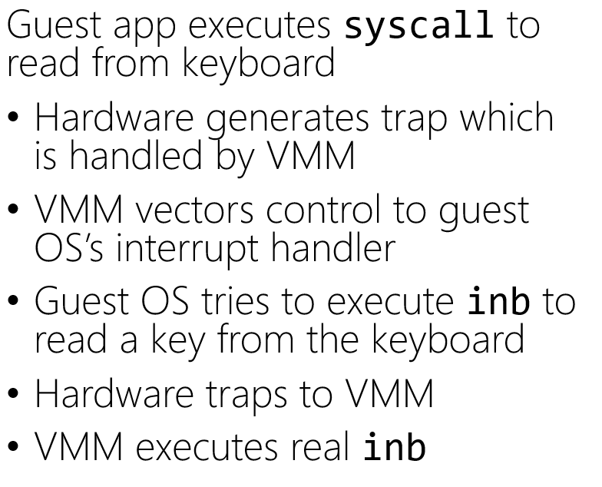
X86 Hand-Off
The guest OS does an iret/sysexit, thinking that the privilege level will flip from 0 to 3 . . . but both the guest OS and the guest apps run at 3!
To provide isolation between the guest OS and guest apps, the VMM must do gross bookkeeping during “context switches” between the guest OS and guest apps!
Guest apps
VMM places result where the guest OS expects it to be
VMM vectors control back to the guest OS
Guest OS does some processing and then does an iret/sysexit
Hardware traps to VMM
VMM returns to user-mode
Ring 3
Guest OS
VMM
Ring 0
x86

Slide 20
x86 Hand-Off
The VMM must detect a context switch from the guest OS to the guest user-level, and unmap guest OS state from the virtual address space! Afterwards, just VMM state is mapped into Ring 0 memory, and guest app state is mapped into Ring 3 memory.
Kernel static data
Kernel code
Kernel heap+stacks
All of this is in Ring 3!
Physical memory map
Empty gap
Stack
Heap
Static data
Code
Notes:
Here’s an example of the complex bookkeeping: most guest OSes place the kernel at the top of a virtual address space. In other words, the kernel is mapped into every process’s address space. In a normal scenario, this is safe because the page table entries for kernel memory are marked as “supervisor access only.” However, in the virtualization setup that I’ve described in this slide, both kernel memory and user-level memory are mapped into Ring 3 (i.e., unprivileged) memory! So, if a hypervisor wants to provide isolation between user-level guest code and kernel-level guest code, the hypervisor has to ensure that, when the guest OS writes to %cr3, the hypervisor actually UNMAPS the kernel code from the real page table that the hardware sees.
[Aside: Section 6.2.1 of Bugnion2012 discusses the page table problem in the context of x86-64 (which lacks segmentation support). Quoth the paper: “We did evaluate alternatives that relied on paging rather than segmentation . . . Unfortunately, the design alternatives all had two major downsides: first, the x86 architecture defined only one single protection bit at the page level (pte.us). Since we require three levels of protection (VMM, guest kernel, guest applications), the VMM would need to maintain two distinct page tables: one for guest applications and VMM, the other for guest kernel (running at %cpl=3!) and VMM. Second, and probably most critically, binary translators always need a low-overhead and secure mechanism to access their own supporting data structures from within translated code. Without hardware segment limit checking, we would lose the opportunity to use hardware-based segmentation and instead would have had to build a software fault isolation framework.” Remember that the VMM needs to isolate the VMM from the guest OS and the guest apps, and the guest OS from the guest apps. On x86-32, this was done by placing the VMM at Ring 0, the guest OS at Ring 1, and the guest apps at Ring 3. The paging hardware only differentiates between “user” (Ring 3) and “supervisor” (Rings 0, 1, and 2), so paging can only protect the VMM and the guest OS from guest apps. However, segments can prevent Ring 1 guest OS code from accessing Ring 0 VMM code.]

Slide 21
Sample Hypervisor Security Issues
CVE-2007-4496, CVE-2007-4497 – ESX3.01, guest operating system can cause buffer overflow and arbitrary code execution in the host
CVE-2007-0948 – Virtual PC – Heap overflow which could cause arbitrary privilege escalation
CVE-2007-4993 – Xen 3.0.3 – User can escape to domain0 via grub.conf and pygrub

Slide 22
The x86 push instruction was not PG-virtualizable!
push can push a register value onto the top of the stack
%cs register contains (among other things) 2 bits that represent the current privilege level
A guest OS running in Ring 3 could push %cs and see that the privilege level isn’t Ring 0!
To be virtualizable, push should cause a trap when invoked from Ring 3, allowing the VMM to push a fake %cs value which indicates that the guest OS is running in Ring 0
Notes:
[References: “Analysis of the Intel Pentium’s Ability To Support A Secure Virtual Machine Monitor” http://www.cse.psu.edu/~buu1/teaching/spring06/papers/analysis-pentium.pdf
https://pdos.csail.mit.edu/6.828/2005/lec/l17.html]

Slide 23
The x86 pushf/popf instructions weren’t PG-virtualizable!
pushf/popf read/write the %eflags register using the value on the top of the stack
Bit 9 of %eflags enables interrupts
In Ring 0, popf can set bit 9, but in Ring 3, CPU silently ignores popf!
To be virtualizable, pushf/popf should cause traps in Ring 3
Allows VMM to detect when guest OS wants to changes its interrupt level (meaning that the VMM should change which interrupts it forwards to the guest OS)
x86 had 17 non-PG-virtualizable instructions!

Slide 24
Early Trends – Consolidate common security functions to security appliance
AV
F
W
AV
F
W
AV
F
W
AV
F
W
AV
F
W
AV
F
W
OS
OS
OS
OS
OS
OS
Enterprise Hypervisor
Hardware
Security Appliance Manager
Antivirus
Firewall
OS
OS
OS
OS
OS
OS
Enterprise Hypervisor
AV Shim
FW Shim
Hardware

Slide 25
Dynamic Translation
mov 32(%rbp), %rbx
sub %rbx, %rcx
push %rcx
popf //Sensitive instruction,
//but not privileged!
//Won’t trap when called
//in Ring 3.
Original guest OS code
Suppose that:
VMM runs in Ring 0
Guest OS and guest apps run in Ring 3
Allow guest user-level programs to run directly atop hardware . . .
. . . but the VMM rewrites the guest OS’s binary on-the-fly!
Translate sensitive-but-unprivileged instructions into ones that trap to the VMM
Translation starts when the VMM initially loads the guest OS binary
Translator handles a few instructions at a time (no bigger than a basic block)
VMM caches frequently-used translations to amortize translation costs
Constant traps to the VMM hurt performance!
mov 32(%rbp), %rbx
sub %rbx, %rcx
push %rcx
int3
//A special one-byte
//instruction that traps.
//Originally intended for
//use by debuggers to set
//breakpoints.
Translated guest OS code
Notes:
[Refs: https://en.wikipedia.org/wiki/INT_(x86_instruction)#INT3
“Bringing Virtualization to the x86 Architecture with the Original VMware Workstation” http://www.cs.columbia.edu/~cdall/candidacy/pdf/Bugnion2012.pdf
“A Comparison of Software and Hardware Techniques for x86 Virtualization” https://www.vmware.com/pdf/asplos235_adams.pdf
https://www.anandtech.com/show/2480/5]

Slide 26
Intel VT-x
VT-x doesn’t change the complex semantics of preexisting x86 instructions
Instead, VT-x:
Defines a VMCS (VM Control Structure): A 4KB chunk of memory that contains a VM’s register state
Creates two new privilege modes (root and non-root) that are orthogonal to ring privileges
VMMs run in root mode
VMs run in non-root mode
Gives each CPU a VMCS pointer register (only configurable by root-mode software)
The two modes use different address spaces (because they use different %cr3’s)!
Notes:
[Aside: As described by the first reference below, “The processor state includes segment registers, the CR3 register, and the interrupt descriptor table register (IDTR). The CR3 register (control register 3) holds the physical location of the page tables. By loading and storing this register on VM entry and exit, guest virtual machines can run in an entirely separate address space than the VMM. However, the VMCS does not contain any general purpose registers as the VMM can do this as needed. This improves VM entry and VM exit performance. On a related note, a guest’s VMCS is referenced with a physical address to avoid first translating a guest virtual address.”]
[Ref: https://cseweb.ucsd.edu/~jfisherogden/hardwareVirt.pdf, and Chapter 4 of “Hardware and Software Support for Virtualization" by Bugnion, Nieh, and Tsafrir. hw-sw-virtualization.pdf

Slide 27
Intel VT-x
VMM launches a VM by:
Configuring the VM’s VMCS page in memory
Setting a core’s VMCS pointer to point to the VMCS page
Calling vmlaunch/vmresume, which context switches to a VM by copying the VM’s register state from the VMCS page into the CPU’s registers
A VM relinquishes control to the VMM:
By voluntarily invoking vmexit or vmcall
By invoking a sensitive instruction
When an interrupt occurs
In all cases, the VM’s register state is saved in the VM’s VMCS page
During a mode switch, hardware automatically and atomically saves register state!
VMM->VM: The VM’s register state is loaded from the VMCS onto the CPU, and the VMM’s state is saved in the VMCS
VM->VMM: The VMM’s register state is loaded from the VMCS onto the CPU, and the VM’s state is saved in the VMCS
Notes:
[As described by Intel’s documentation [3], “There is no software-visible bit whose setting indicates whether a logical processor is in VMX non-root operation. This fact may allow a VMM to prevent guest software from determining that it is running in a virtual machine. Because VMX operation places restrictions even on software running with current privilege level (CPL) 0, guest software can run at the privilege level for which it was originally designed. This capability may simplify the development of a VMM . . . A VMM could use a different VMCS for each virtual machine that it supports. For a virtual machine with multiple logical processors (virtual processors), the VMM could use a different VMCS for each virtual processor.“]
[As described in Section 24.4 of Reference [3], strictly speaking, a VMCS does not store *all* of the register state for a swapped-out VM. Instead, it only stores %rip, %rsp, the segment registers (e.g., %cs and %gs), and some other control registers like %cr3. The hypervisor is responsible for saving the rest of the VM’s registers.]
[Ref: [1] https://cseweb.ucsd.edu/~jfisherogden/hardwareVirt.pdf
[2] Chapter 4 of “Hardware and Software Support for Virtualization" by Bugnion, Nieh, and Tsafrir. hw-sw-virtualization.pdf
[3] https://www.intel.com/content/dam/www/public/us/en/documents/manuals/64-ia-32-architectures-software-developer-vol-3c-part-3-manual.pdf
]

Slide 28
VM 1
VM 2
User apps
Ring 3
User apps
Ring 3
Nothing
Ring 2
Nothing
Ring 2
Non-root
Non-root
Nothing
Ring 1
Nothing
Ring 1
OS
Ring 0
OS
Ring 0
User apps
Ring 3
Nothing
Ring 2
Root
Nothing
Ring 1
VMM
Ring 0

Slide 29
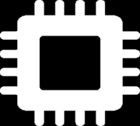
VM 1
VM 2
VMM-controlled “extended” page table!
User apps
Ring 3
User apps
Ring 3
VMM pages
VMM
Nothing
Ring 2
Nothing
Ring 2
VM₀
Non-root
Non-root
VM₁ pages
Nothing
Ring 1
Nothing
Ring 1
%ept
OS
Ring 0
OS
Ring 0
VM₀ pages
%cr3
%vmcsPointer
User apps
Ring 3
VMCS₁
[VM₁ state]
Nothing
Ring 2
Root
VMCS₀
Nothing
Ring 1
vmptrld
[VM₀ state]
[VMM state]
vmlaunch
VMM
Ring 0
RAM
Notes:
[Note that a VM-level page fault only traps to the VMM if the page fault is induced by the EPT part of the page walk! In other words, if an address translation hits an unmapped region in the guest %cr3’s page table, the page fault is handled by the guest OS. However, if an address translation hits an unmapped region in the EPT’s page table, then the fault is sent to the VMM.]
[Even if non-root mode has disabled interrupts, the arrival of an interrupt will cause a trap to the VMM if non-root code is running. See page 56 of the reference below.]
[Ref: Chapter 4 of “Hardware and Software Support for Virtualization" by Bugnion, Nieh, and Tsafrir. hw-sw-virtualization.pdf

Slide 30
Virtualizing the MMU
Goals
Allow a guest OS to believe that it controls the virtual-to-physical mapping
Enable a VMM to actually control which guest pages live in RAM and where those pages live
Definitions
Guest virtual memory: Visible to guest applications (user+kernel)
Guest physical memory: What the guest OS maps guest virtual memory to
Host physical memory: What the VMM maps guest physical memory to

Slide 31
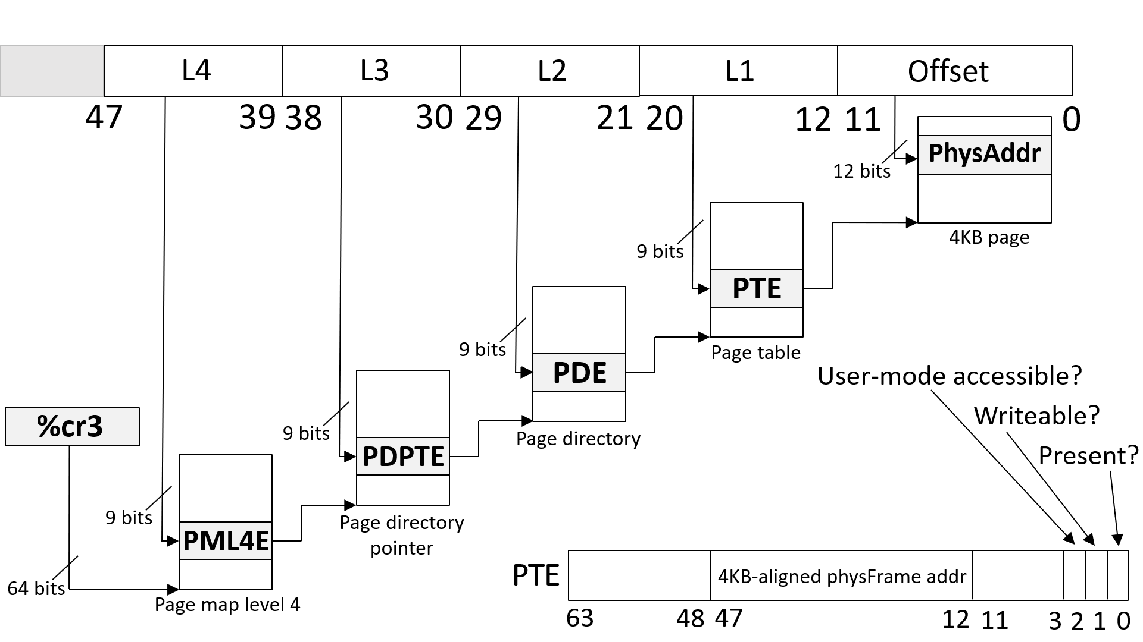
Intel VT-x EPT
Guest-level %cr3 and page tables contain guest physical addresses
VMM needs to translate each of those addresses to host physical addresses
Root mode and non-root mode have their own %cr3
However, the VMM manages a hidden EPT (“extended page table”) register which is consulted when a TLB miss occurs in non-root mode
An extended page table maps guest physical addresses to host physical addresses
During a TLB miss in non-root mode, the hardware:
Uses the EPT to translate each guest physical address in layers 4, 3, 2, and 1 of the non-root page table
Installs the appropriate guest-virtual to host-physical mapping in the TLB
Using the EPT, the hypervisor controls how host physical RAM is actually used
EPT translation is:
Enabled during VM entry: hardware loads EPT register using a saved value in the VMCS
Disabled during VM exit: hardware saves the current EPT register in the VMCS
TLB is flushed during a root<-->non-root transition
Note that a TLB miss is not a transition!

Slide 32
Handling a TLB miss on an EPT processor
In non-root mode, a TLB entry maps a guest virtual page to a host physical page
The PTE at the bottom-right of the slide contains the host physical page number for the guest virtual address which caused the TLB miss
EPT makes address translation much slower!
Regular x86-64 page walk: 4 memory accesses
EPT page walk: 24 memory accesses
Luckily, VT-x processors maintain caches for various intermediate mappings
Notes:
[See https://googleprojectzero.blogspot.com/2019/01/taking-page-from-kernels-book-tlb-issue.html (section “Introduction: TLBs and paging-structure caches”) for a good overview of TLBs and (developer-hidden) on-chip caches for intermediate (i.e., non-leaf) page table entries.]

Slide 33
Guest %cr3
VMM-managed %ept
(i.e., pointer to PML4)
(i.e., pointer to PML4)
gPA
hPA
⊕
Index
Memory read
hPA
PML4E
Next slide . . .
⊕
Index
Memory read
hPA
PDPTE
⊕
Index
Memory read
hPA
PDE
The host physical address where the hypervisor put the guest’s PML4 table
⊕
Index
Memory read
hPA
PTE

Slide 34
Guest physical address
VMM-managed %ept
of L3 table
(i.e., pointer to PML4)
gPA
hPA
⊕
Index
Memory read
hPA
PML4E
Output of prior slide
⊕
Guest virtual
Host physical
Index
Memory read
address to
address of guest’s
hPA
PDPTE
translate
PML4 table
gVA
hPA
⊕
Index
Memory read
⊕
hPA
PDE
Index
Memory read
gPA
PML4E
⊕
Index
(Contains guest physical
Memory read
address of L3 table)
hPA
PTE

Slide 35
Guest physical address
VMM-managed %ept
of L2 table
(i.e., pointer to PML4)
gPA
hPA
⊕
Index
Memory read
hPA
PML4E
Output of prior slide
⊕
Guest virtual
Host physical
Index
Memory read
address to
address of guest’s
hPA
PDPTE
translate
L3 table
gVA
hPA
⊕
Index
Memory read
⊕
hPA
PDE
Index
Memory read
gPA
PDPTE
⊕
Index
(Contains guest physical
Memory read
address of L2 table)
hPA
PTE

Slide 36
Guest physical address
VMM-managed %ept
of L1 table
(i.e., pointer to PML4)
gPA
hPA
⊕
Index
Memory read
hPA
PML4E
Output of prior slide
⊕
Guest virtual
Host physical
Index
Memory read
address to
address of guest’s
hPA
PDPTE
translate
L2 table
gVA
hPA
⊕
Index
Memory read
⊕
hPA
PDE
Index
Memory read
gPA
PDE
⊕
Index
(Contains guest physical
Memory read
address of L1 table)
hPA
PTE

Slide 37
Guest physical address
VMM-managed %ept
of target physical page
(i.e., pointer to PML4)
gPA
hPA
⊕
Index
Memory read
hPA
PML4E
Output of prior slide
⊕
Guest virtual
Host physical
Index
Memory read
address to
address of guest’s
hPA
PDPTE
translate
L1 table
gVA
hPA
⊕
Index
Memory read
⊕
hPA
PDE
Index
Memory read
gPA
PTE
⊕
Index
(Contains guest physical
Memory read
address of target physical page)
hPA
PTE

